Slide 1
Module 4:
The Internet Transport Protocols

Slide 2
The Internet Transport Protocols: Introduction to TCP and UDP, The TCP Service Model,
The TCP Segment Header, The Connection Establishment, The TCP Connection Release,
The TCP Connection Management Modeling, The TCP Sliding Window, The TCP
Congestion Control, The future of TCP.

Slide 3
Introduction to TCP
TCP (Transmission Control Protocol) was specifically designed to provide a reliable end-to end byte stream over an unreliable internetwork.
An internetwork differs from a single network because different parts may have wildly different topologies, bandwidths, delays, packet sizes, and other parameters.
TCP was designed to dynamically adapt to properties of the internetwork and to be robust in the face of many kinds of failures.

Slide 4
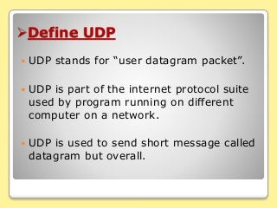

Slide 5
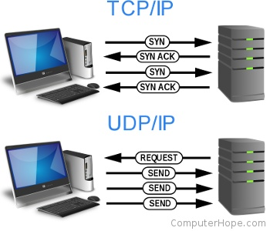
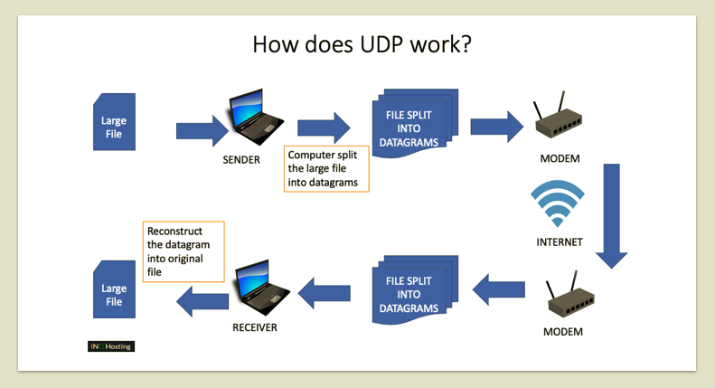

Slide 6
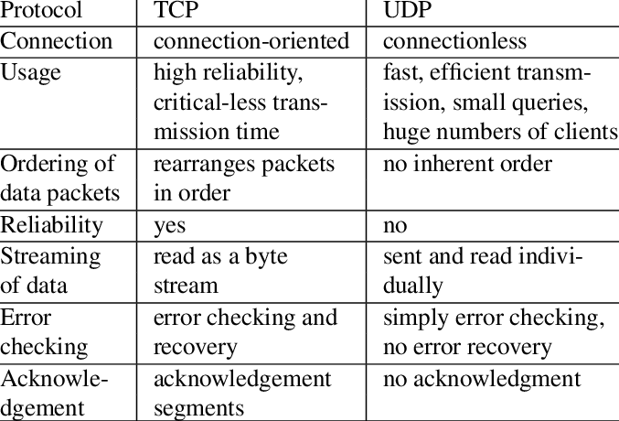

Slide 7
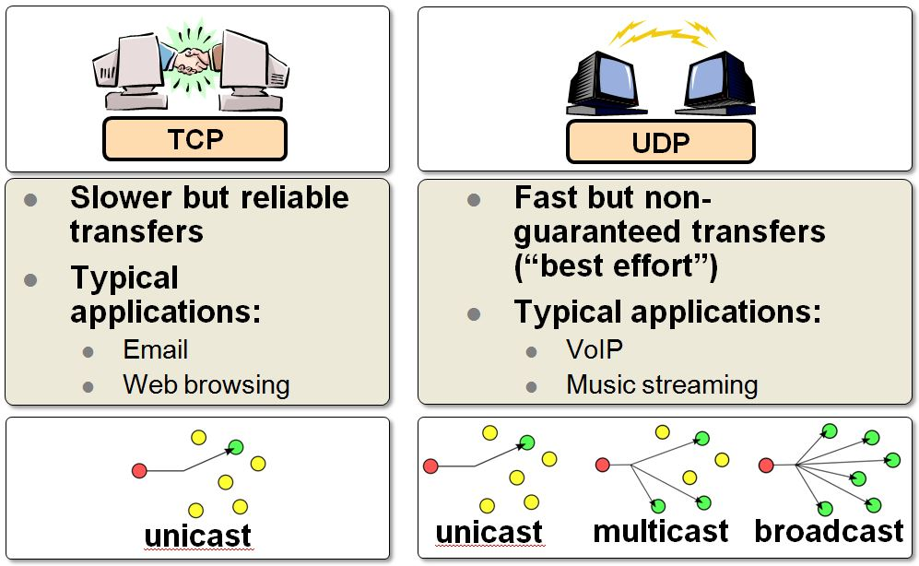

Slide 8
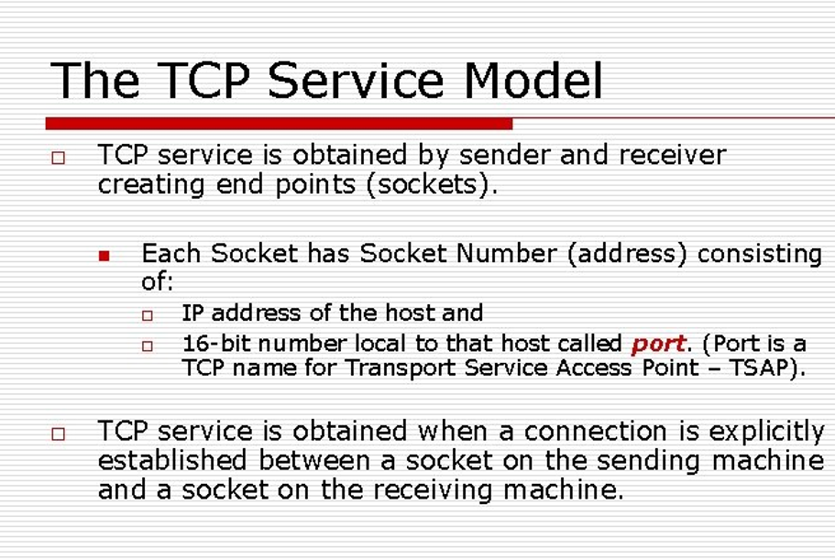
Notes:
Transport Service access point

Slide 9
The TCP Service Model
TCP service is obtained by both the sender and receiver creating end points, called sockets, as
Each socket has a socket number (address) consisting of the IP address of the host and a 16-bit number local to that host, called a port
Port numbers below 1024 are called well-known ports and are reserved for standard services.
single daemon, called inetd (Internet daemon) in UNIX, attach itself to multiple ports and wait for the first incoming connection

Slide 10
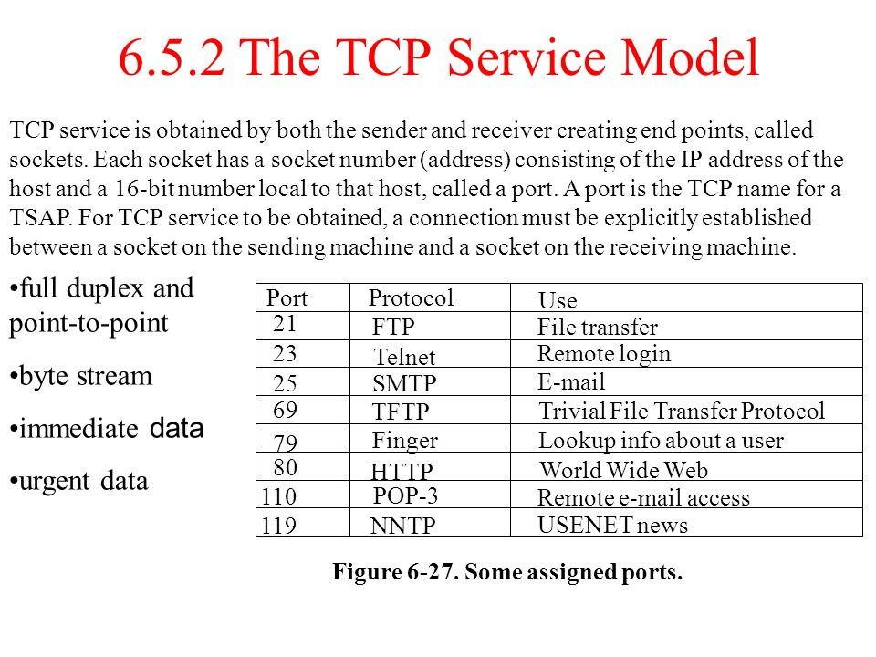

Slide 11
The Transmission Control Protocol (TCP)
TCP is a protocol that specifies:
How to distinguish among multiple destinations on a given machine
How to initiate and terminate a stream transfer
Format of the data and acknowledgments that two computers exchange to achieve a reliable transfer
Procedures the computers use to ensure that the data arrives correctly

Slide 12
The TCP Protocol
A key feature of TCP, and one which dominates the protocol design, is that every byte on a TCP connection has its own 32-bit sequence number.
A TCP segment consists of a fixed 20-byte header (plus an optional part) followed by zero or more data bytes. The TCP software decides how big segments should be.
First, each segment, including the TCP header, must fit in the 65,515-byte IP payload. Second, each network has a maximum transfer unit, or MTU, and each segment must fit in the MTU.

Slide 13
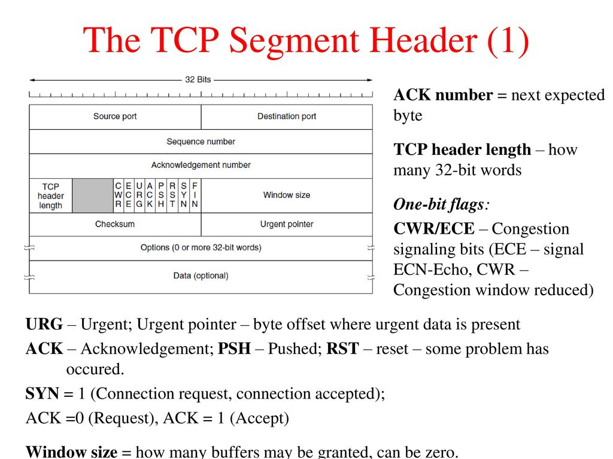
The TCP Segment Header

Slide 14
TCP Segment Format
TCP divides the data stream into segments for transmission:
0 4 10 16 24 31
SOURCE PORT DESTINATION PORT
SEQUENCE NUMBER
ACKNOWLEDGMENT NUMBER
HLEN RESERVED CODE BITS WINDOW
CHECKSUM URGENT POINTER
OPTIONS (IF ANY) PADDING
DATA
...

Slide 15
TCP Segment Header Fields
Code bits - identify the contents of the segment:
Window - how much data the sender is willing to accept (flow control)
Urgent pointer - specifies the position in the segment where urgent data ends

Slide 16
Out of Band Data
TCP provides a mechanism to handle urgent data
Urgent data is received before octets already in the stream
Sender:
Sets urgent bit in segment header
Puts urgent data at the beginning of the data field
Sets urgent pointer to the end of the urgent data
Receiver:
Notified of the urgent data as soon as it arrives
Enters “urgent mode” until all urgent data has been consumed
Returns to “normal mode”

Slide 17
TCP Segment Header Fields (cont)
Checksum - used to verify the integrity of the segment
Computed over:
Segment header
Segment data
Pseudo header
1’s complement addition algorithm
Options - signal various options
Maximum segment size

Slide 18
TCP - Acknowledgments and Retransmission
Uses cumulative acknowledgment scheme:
ACK 7 = “all octets up to but not including number 7 have been received correctly”
Advantages
ACKs are easy to generate and unambiguous
Lost acknowledgments do not force retransmission
Disadvantages
Sender does not receive information about all successful transmissions

Slide 19
TCP - Timeout and Retransmission
For each segment sent:
Start timer and wait for acknowledgment
Retransmit if timer expires
TCP uses an adaptive retransmission algorithm because internet delays are so variable
Round trip time of each connection is recomputed every time an acknowledgment arrives
Timeout value is adjusted accordingly

Slide 20
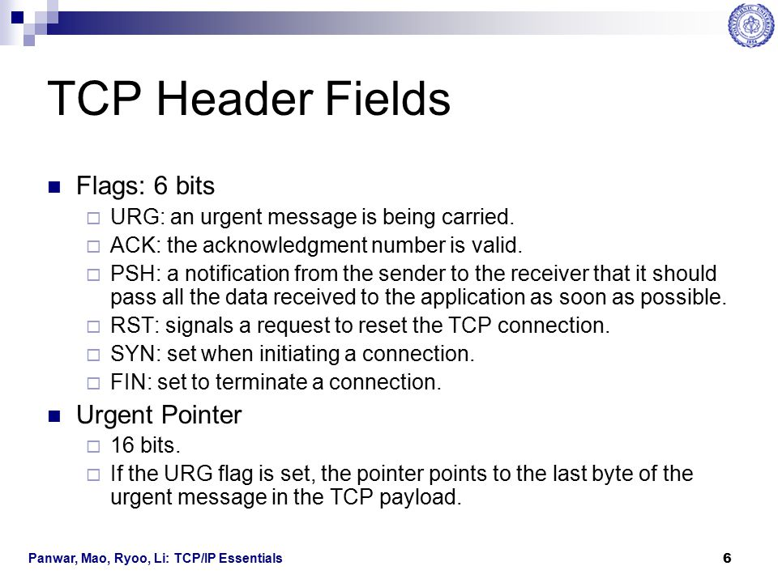

Slide 21
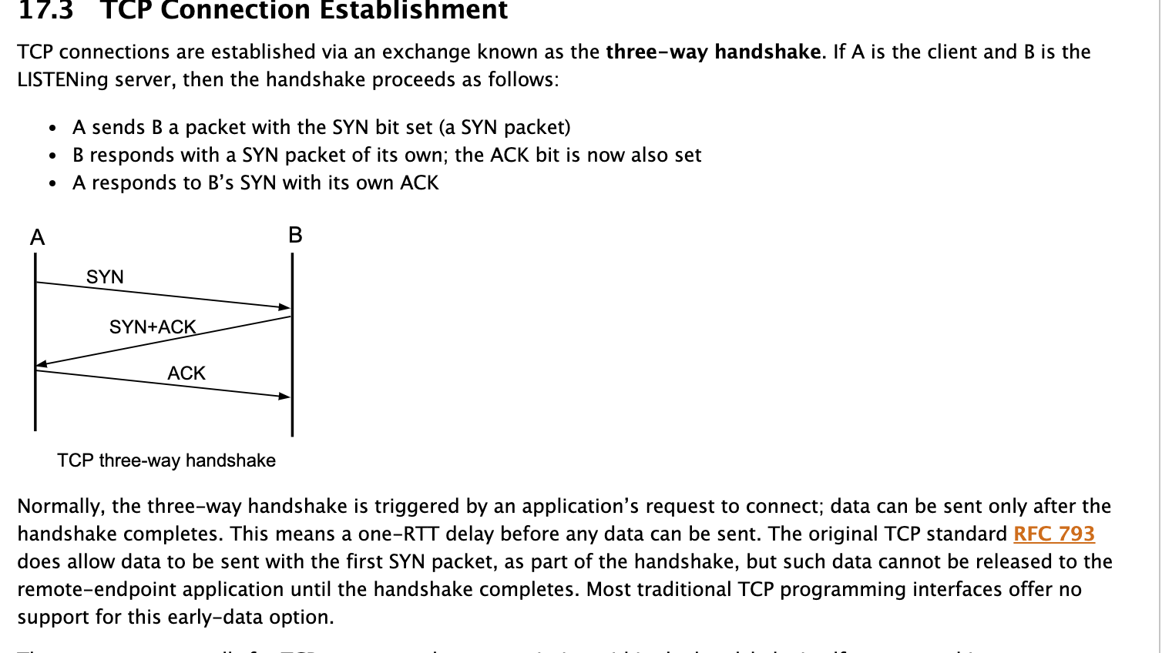

Slide 22
Three-Way Handshake or a TCP 3-way handshake is a process which is used in a TCP/IP network to make a connection between the server and client.
It is a three-step process that requires both the client and server to exchange synchronization and acknowledgment packets before the real data communication process starts.
Three-way handshake process is designed in such a way that both ends help you to initiate, negotiate, and separate TCP socket connections at the same time.
It allows you to transfer multiple TCP socket connections in both directions at the same time.

Slide 23
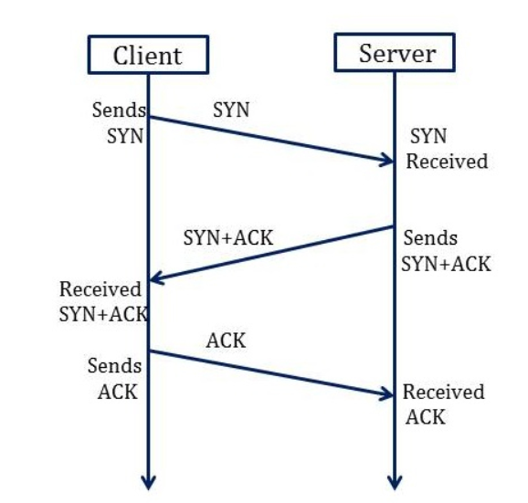

Slide 24
TCP message types
Message | Description
Syn | Used to initiate and establish a connection. It also helps you to synchronize sequence numbers between devices.
ACK | Helps to confirm to the other side that it has received the SYN.
SYN-ACK | SYN message from local device and ACK of the earlier packet.
FIN | Used to terminate a connection.

Slide 25
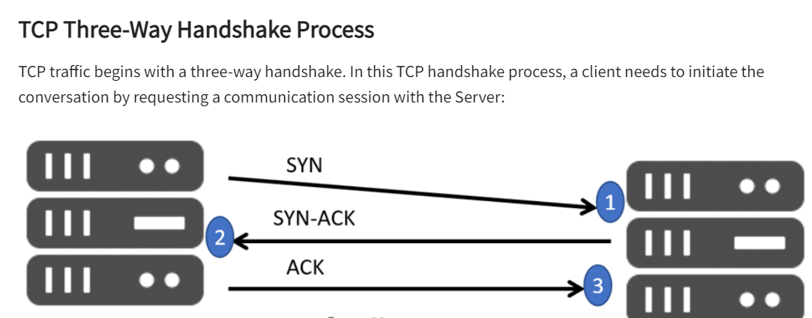
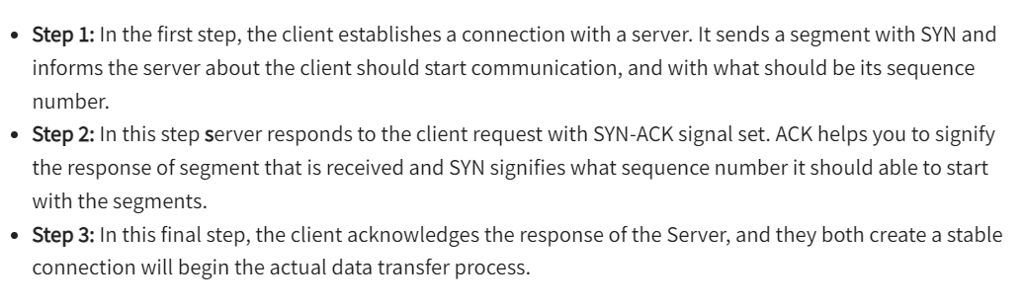

Slide 26
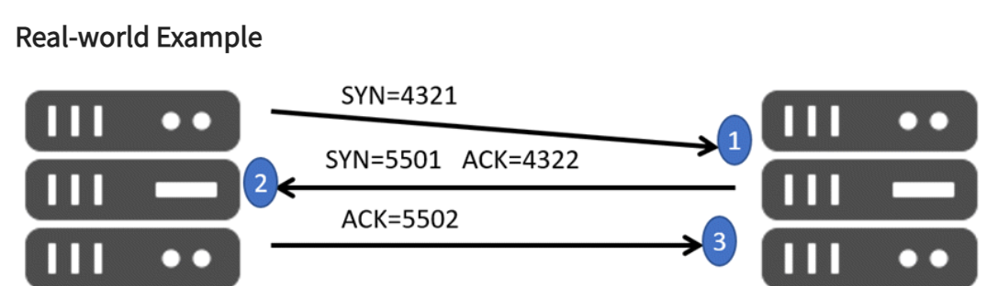
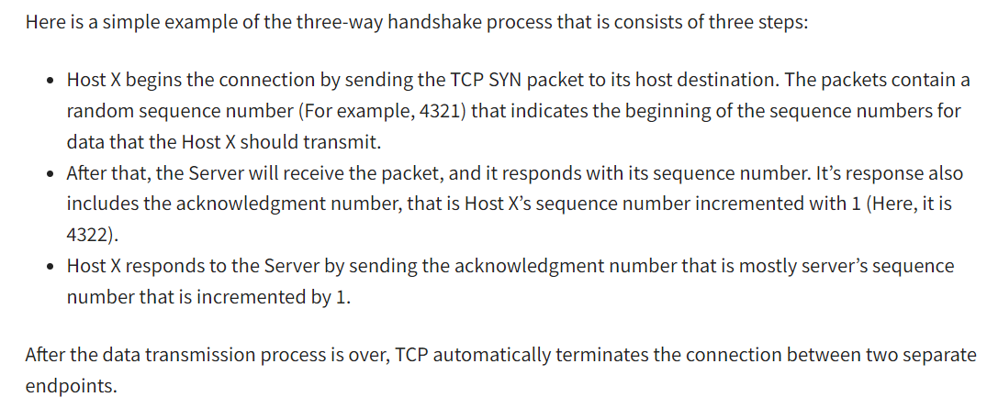

Slide 27
What is connection release in TCP?
Releasing a TCP connection is symmetric
. Either port can send a TCP segment with the FIN bit set, meaning it has no more information to send when the FIN is acknowledged that direction is shut down.
Still, data can continue to flow continually in the other direction.

Slide 28
TCP Connection Release
One way to avoid data loss is to use symmetric release, in which each direction is released independently of the other one.
One can envision a protocol in which host 1 says: I am done. Are you done too? If host 2 responds: I am done too. Goodbye, the connection can be safely released.
Unfortunately, this protocol does not always work.

Slide 29
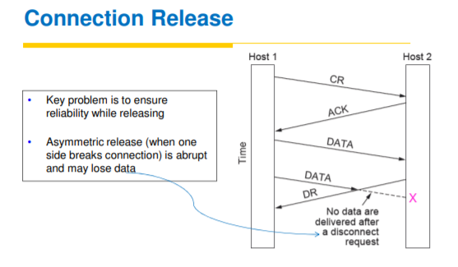

Slide 30
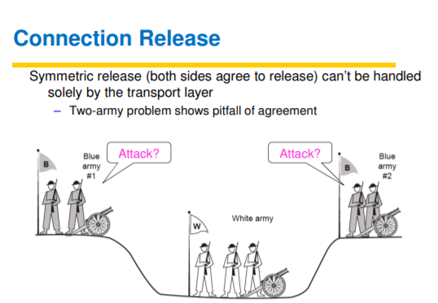

Slide 31
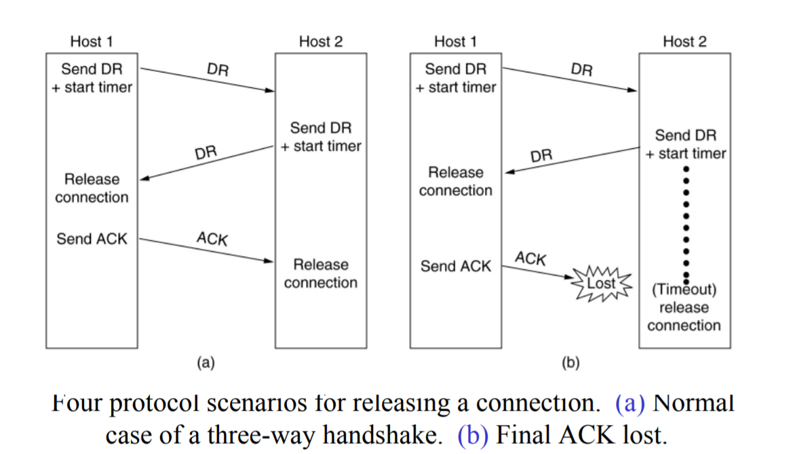
Connection Release

Slide 32
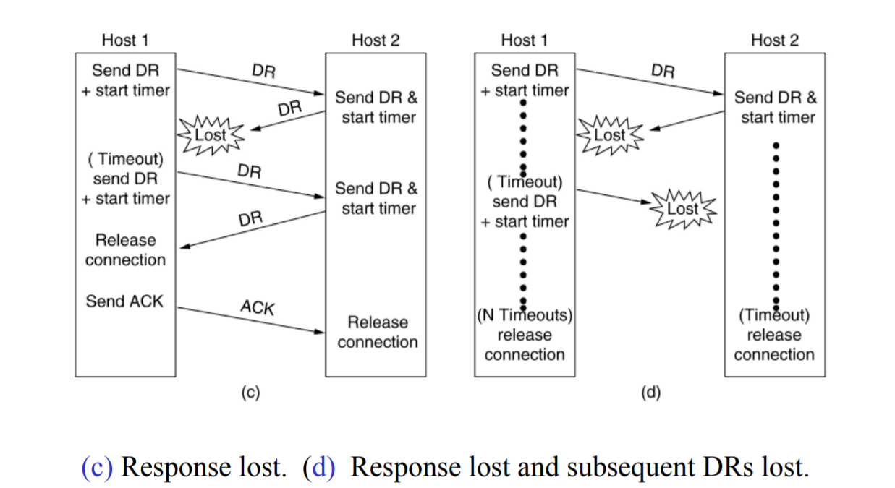
Connection Release

Slide 33
1. Asymmetric: either side issues disconnect, connection will be released.
2. Symmetric: both the side need to separately execute disconnect.

Slide 34
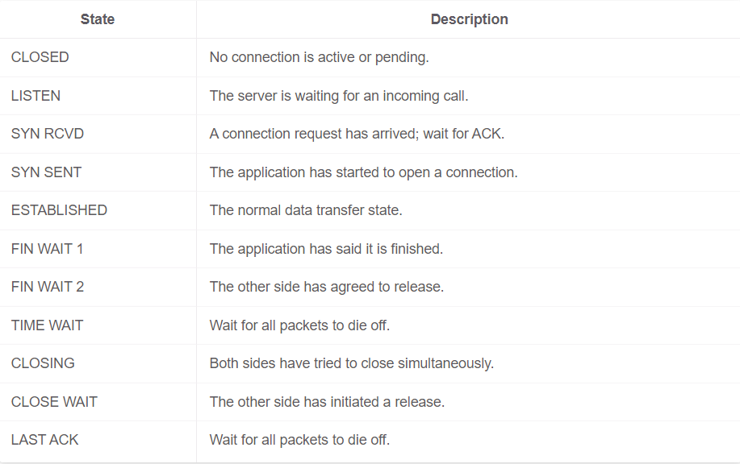
TCP connection management modeling
The steps of a establishing and releasing a TCP connection can be represented as a finite state machine with 11 states.

Slide 35
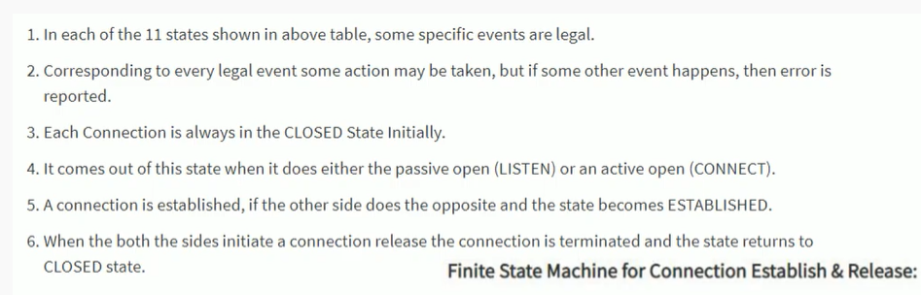

Slide 36
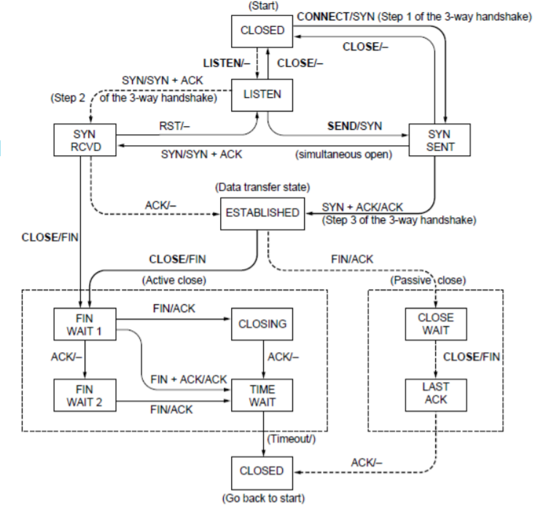
TCP connection management modeling
Solid line is the normal path for a client.
Dashed line is the normal path for a server.
Light lines are unusual events.
Transitions are labeled by the cause and action, separated by a slash.

Slide 37
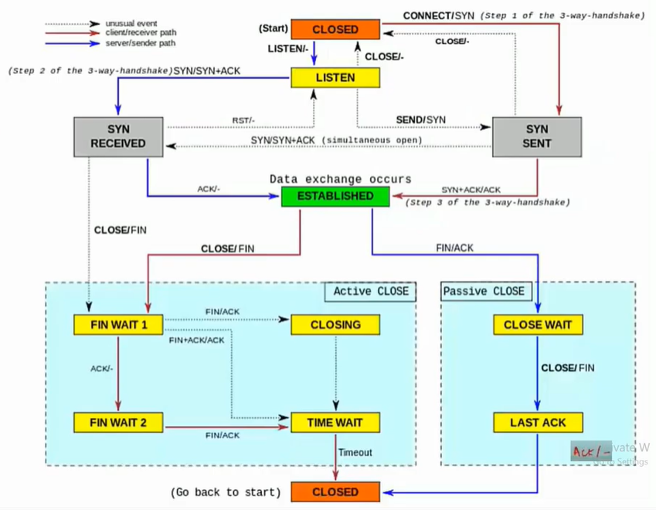
What is active close and passive close in TCP?
The program that initiates the closedown process by issuing the first close() call is said to initiate an active close.
The program that closes in response to the initiation is said to initiate a passive close.

Slide 38
TCP sliding window
The TCP sliding window determines the number of unacknowledged bytes, x , that one system can send to another. Two factors determine the value of x :
The size of the send buffer on the sending system.
The size and available space in the receive buffer on the receiving system.

Slide 39
Why does TCP use a sliding window?
"TCP windowing" is what we call it when the Transmission Control Protocol (TCP) uses a sliding window protocol to mitigate problems with clients and servers trying to share segments of data that are too large or small, and therefore cannot transmit effectively

Slide 40
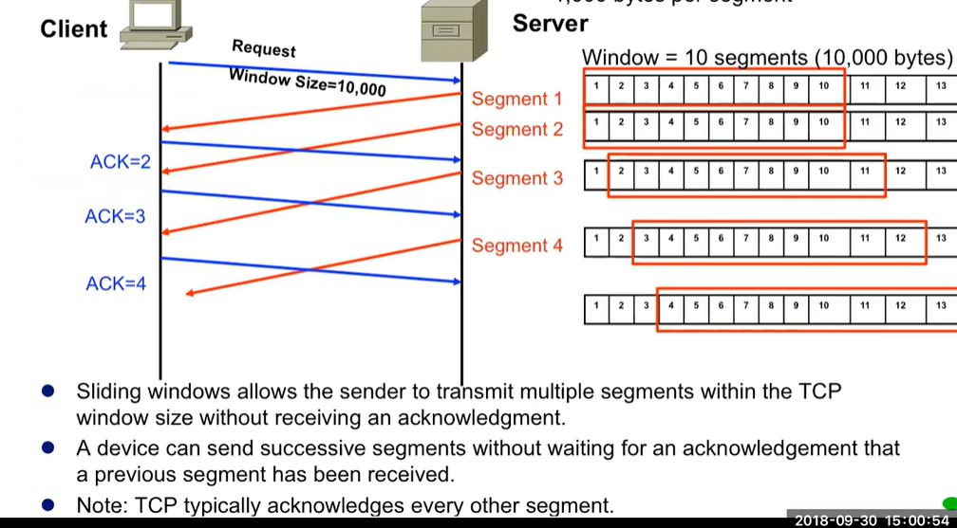

Slide 41
TCP Sliding Window:
window management in TCP decouples the issues of acknowledgement of the correct receipt of segments and receiver buffer allocation. For example, suppose the receiver has a 4096-byte buffer, as shown in Fig. 6-40.
If the sender transmits a 2048-byte segment that is correctly received, the receiver will acknowledge the segment. However, since it now has only 2048 bytes of buffer space (until the application removes some data from the buffer), it will advertise a window of 2048 starting at the next byte expected.
Now the sender transmits another 2048 bytes, which are acknowledged, but the advertised window is of size 0.
The sender must stop until the application process on the receiving host has removed some data from the buffer, at which time TCP can advertise a larger window and more data can be sent.
When the window is 0, the sender may not normally send segments, with two exceptions.
First, urgent data may be sent, for example, to allow the user to kill the process running on the remote machine.

Slide 42
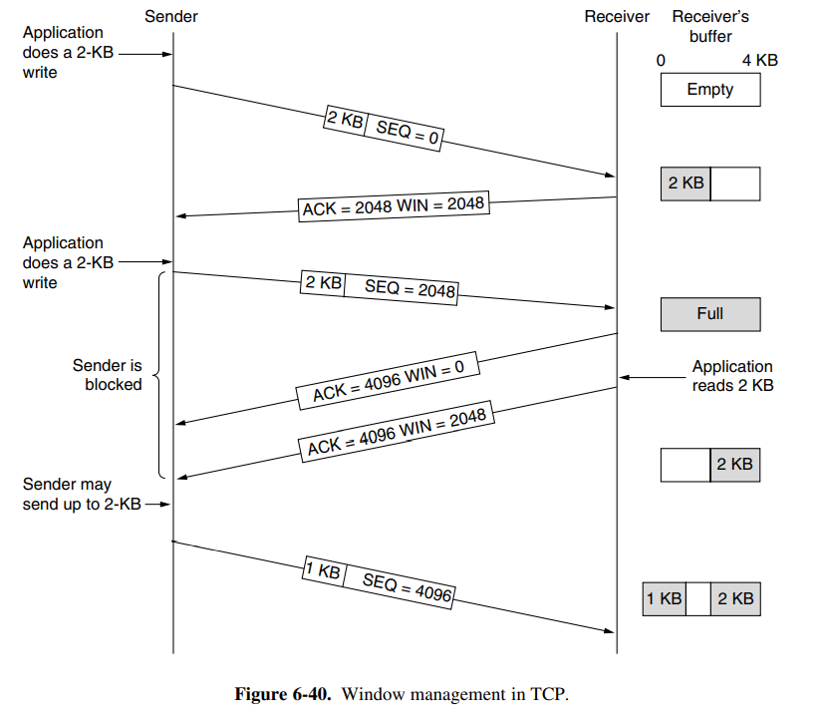

Slide 43
Second, the sender may send a 1-byte segment to force the receiver to reannounce the next byte expected and the window size. This packet is called a window probe. The TCP standard explicitly provides this option to prevent deadlock if a window update ever gets lost.
Senders are not required to transmit data as soon as they come in from the application. Neither are receivers required to send acknowledgements as soon as possible.
For example, in Fig. 6-40, when the first 2 KB of data came in, TCP, knowing that it had a 4-KB window, would have been completely correct in just buffering the data until another 2 KB came in, to be able to transmit a segment with a 4-KB payload. This freedom can be used to improve performance.
Consider a connection to a remote terminal, for example using SSH or telnet, that reacts on every keystroke. In the worst case, whenever a character arrives at the sending TCP entity, TCP creates a 21-byte TCP segment, which it gives to IP to send as a 41-byte IP datagram. At the receiving side, TCP immediately sends a 40-byte acknowledgement (20 bytes of TCP header and 20 bytes of IP header).

Slide 44
Later, when the remote terminal has read the byte, TCP sends a window update, moving the window 1 byte to the right. This packet is also 40 bytes. Finally, when the remote terminal has processed the character, it echoes the character for local display using a 41-byte packet.
In all, 162 bytes of bandwidth are used and four segments are sent for each character typed. When bandwidth is scarce, this method of doing business is not desirable.
One approach that many TCP implementations use to optimize this situation is called delayed acknowledgements. The idea is to delay acknowledgements and window updates for up to 500 msec in the hope of acquiring some data on which to hitch a free ride.
Assuming the terminal echoes within 500 msec, only one 41-byte packet now need be sent back by the remote side, cutting the packet count and bandwidth usage in half.
Although delayed acknowledgements reduce the load placed on the network by the receiver, a sender that sends multiple short packets (e.g., 41-byte packets containing 1 byte of data) is still operating inefficiently. A way to reduce this usage is known as Nagle’s algorithm (Nagle, 1984).

Slide 45
TCP Congestion Control
When the load offered to any networks is more than it can handle, congestion builds up. The Internet is no exception.
Algorithms have been developed over the past decade to deal with congestion.
Although the network layer also tries to manage congestion, most of the heavy lifting is done by TCP because the real solution to congestion is to slow down the data rate.

Slide 46
How does TCP do congestion control?
TCP detects congestion when it fails to receive an acknowledgement for a packet within the estimated timeout.
In such a situation, it decreases the congestion window to one maximum segment size (MSS), and under other cases it increases the congestion window by one MSS.

Slide 47
In theory congestion can be dealt with by employing a principle borrowed from physics: the law of conservation of packets. The idea is not to inject a new packet into the network until an old one leaves (i.e. is delivered). TCP attempts to achieve this goal by dynamically manipulating the Window size.
The first step in managing congestion is detecting it.
A timeout caused by a lost packet could have been caused either
Noise on a transmission line
Packet discarded at a congested router

Slide 48
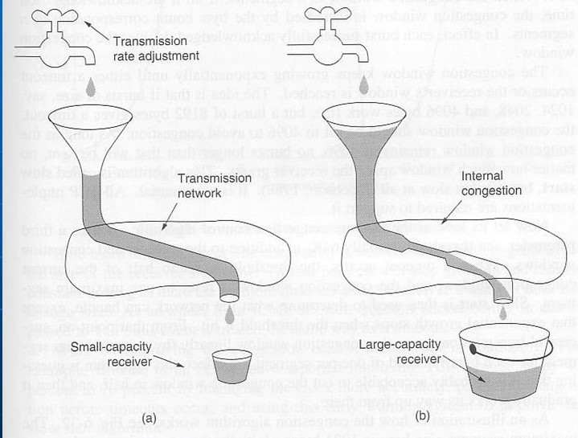
(a) A fast network feeding a low capacity receiver
(b) A slow network feeding a high capacity receiver

Slide 49
The internet solution is to realize that potential problem exist
Sender capacity
Receiver capacity
Each sender maintains two windows: the window the receiver has granted and a second congestion window each reflects the number of bytes that sender may transmit
Each reflects the number of bytes the sender may transmit. The number of bytes that may be sent is the minimum of the two windows.

Slide 50
When a connection is established, the sender initializes the congestion window to the size of the maximum segment in use of the connection. It then sends one maximum segment
If this segment is acknowledged before the timer goes off, it adds one more segment’s worth of bytes to the congestion window to make it two acknowledged
The congestion window keeps growing exponentially until either a timeout occurs or the receiver’s window is reached. This algorithm is called slow start but it is not slow at all (Jacobsan, 1988). It is exponential.

Slide 51
In internet congestion control algorithm, it uses a third parameter, the threshold.
When a timeout occurs, the threshold is set to half of the current congestion window, and the congestion is reset to one maximum segment.
Successful transmissions grow the congestion window linearly (by one maximum segment for each burst) instead of one per segment

Slide 52
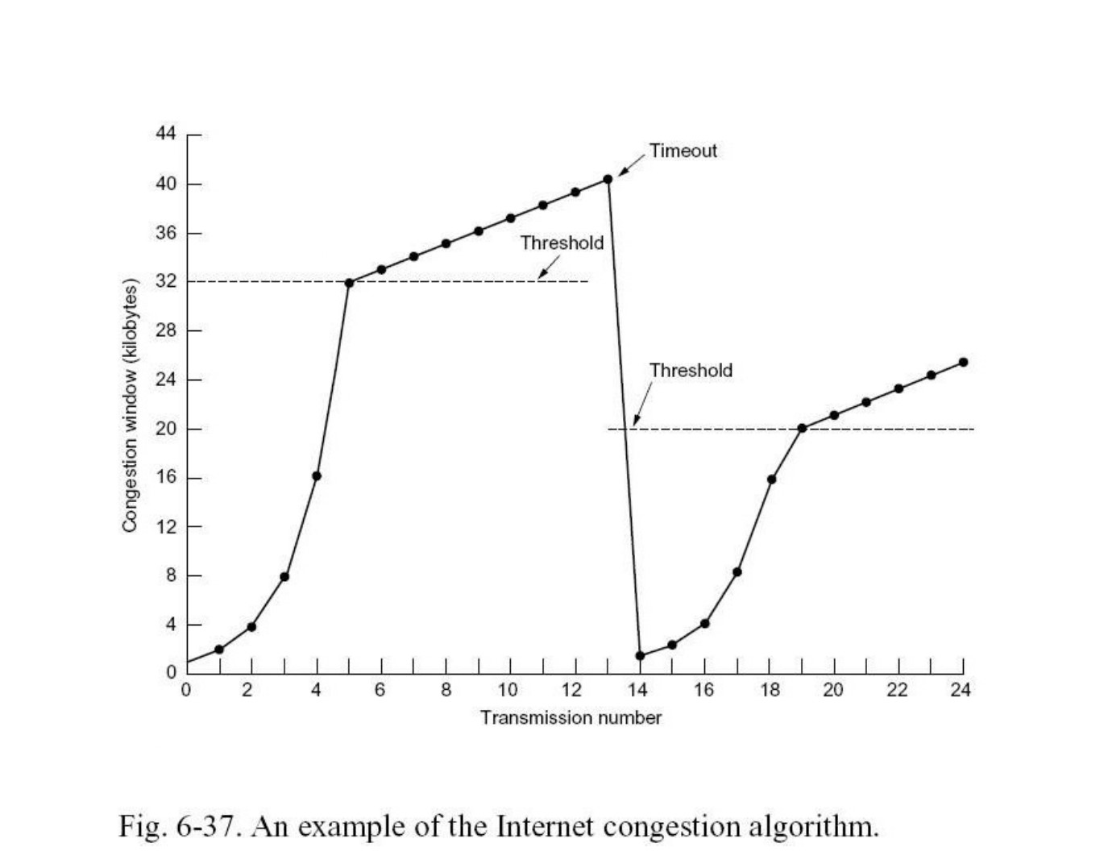

Slide 53
The maximum segment size here is 1024 bytes. Initially, the congestion window was 64KB, but a timeout occurred, so the threshold is set to 32KB and the congestion window to 1 KB for transmission 0 here
The congestion window then grows exponentially until it hits the threshold(32 KB). Starting then it grows linearly

Slide 54
Here, in the above figure, in transmission 13 a timeout occurs.
The transmission is set to half of the current window and then the slow start is initiated all over again. Once the acknowledgements from transmission 14 start coming in, the first four each double the congestion window, but after that, growth becomes linear again.
If no more timeouts occur the congestion window will continue to grow up to the size off the receiver’s window. At that point, it will stop growing and remain constant as long as there are no more timeouts and the receivers window does not change size.

Slide 55
Most Significant Problem
Address Space Limitation
IPv4 address space is exhausted.
To accommodate for Future expansion, IPv6 has been introduced.

Slide 56
Features of IPv6
Larger Address
Flexible Header Format
Improved Options
Support for Resource Allocation
Provision for Protocol extension

Slide 57
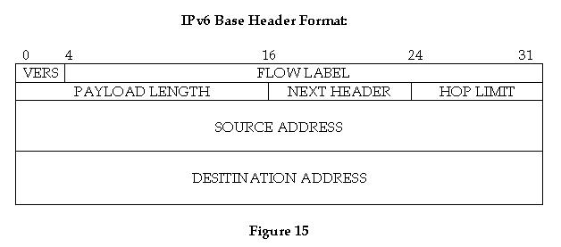

Slide 58
IPv6
VERS: Specifies the version of the protocol
FLOW LABEL: The base header contains information that routers use to associate a datagram with a specific flow and priority.
PAYLOAD LENGTH: Specifies the number of octets carried in the datagram.
NEXT HEADER: Specifies the type of the following header.
HOP LIMIT: This field interprets a time-to-live as a combination of hop count and maximum time.
SOURCE ADDRESS: It requires 16 octets to specify the sender address.
DESTINATION ADDRESS: It requires 16 octets to specify the recipient address.

Slide 59
IPv6 Address Types
Unicast: The destination address specifies a single computer
Cluster: The destination is a set of computers that all share a single address prefix
Multicast The destination is a set of computers, possibly at multiple locations.

Slide 60
Thank You

